Slide 1

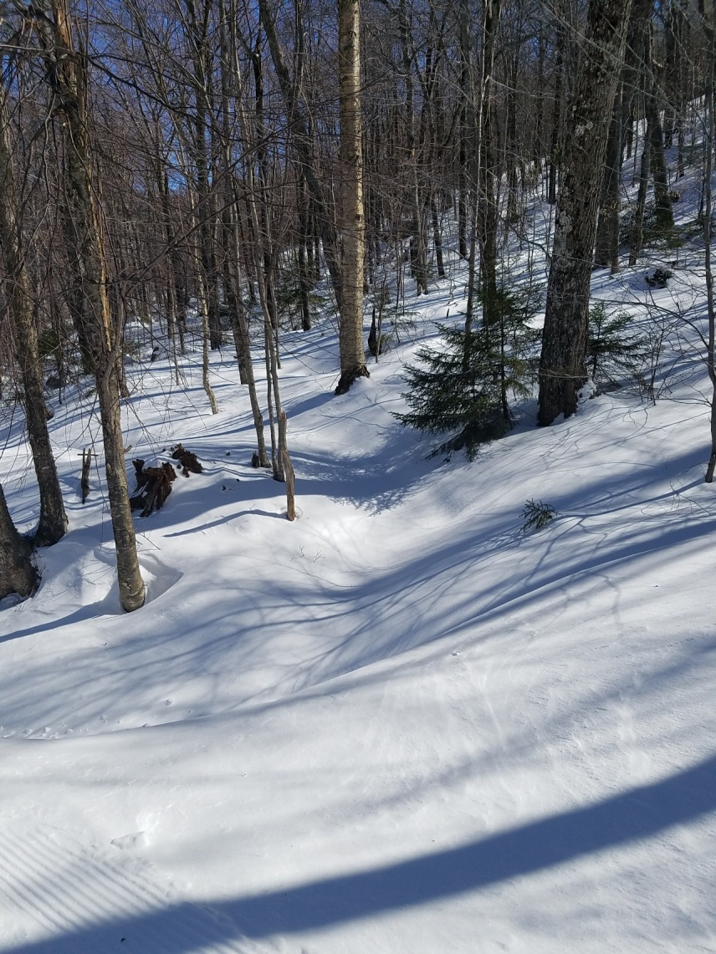

BENEFICAL MICROBES: Sharing of the Microbial Informational Library
Lab Roots: Virtual Microbiology and Immunology
September 13 and 14 , 2017
John G Thomas, PhD, Professor Emeritus,
West Virginia University, Morgantown, WV
Center of Excellence in Biofilm Research,
Allegheny Health Network and Carnegie Mellon
University , DISRUPTIVE
HEALTH TECHNOLOGY INSTITUTE (DHTI),
Pittsburgh, PA
and
Creator, Global Microbiology Consulting ( GMC )

Slide 2
CLINICAL MICRBIOLOGY
LABORATORY DIRECTOR
PATHOLOGY 1969
WVU, SOM
Professor
MOUNTAIN STATE
ORAL FACIAL DENTAL MICROBIOOGY LABORATOY
WVU,
SOD Clinical Professor 1990
Medicine
Dentistry
54 yr
International
Clinical Microbiologist

Slide 3


I. INTRODUCTION
Redefining who we are
Hologenomic Theory of Co Evolution
Dual Citizenship and 2 Passports
Microbes Matter including FUNGI
Think Outside the BOX
7 degrees
Sugarbush Ski Resort, Vermont, USA

Slide 4
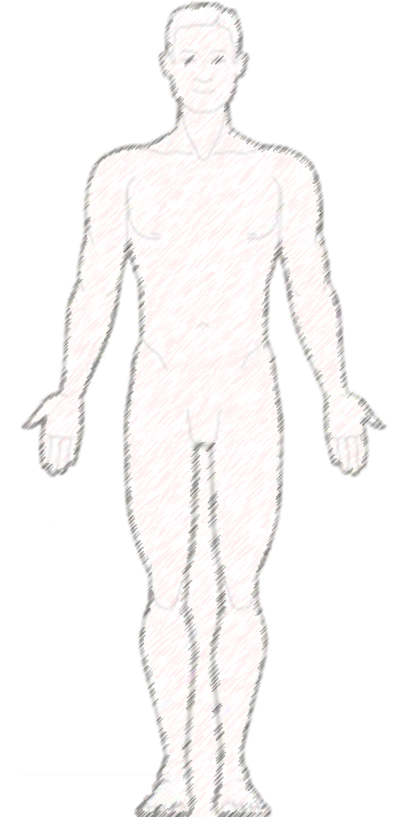
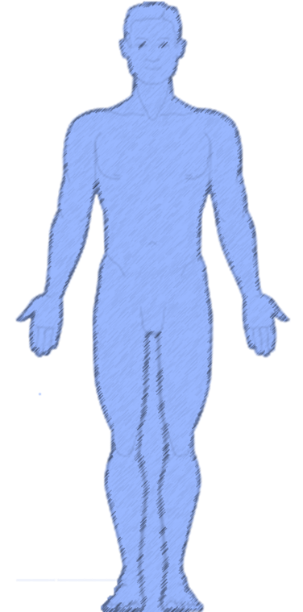
HOLOGENOME Concept of Evolution
“DUAL CITIZENSHIP”
Organisms are sum of their genomic parts: BOTH the host (MACRO) and its total microbiome (MICRO)
Concept relies on continuity of “Dual Partnership” between HOLOBIONT generations including the microbiome
contribution to fitness of HOLOBIONT generations
The HOLOBIONT adds threes genetic variations from the 1. microbial amplification (diet, temp, toxins. And ABX);
2. acquisition of novel strains from the environment; and 3. Horizontal Gene Transfer (HGT) promoted by
biofilms.
SYMBIOSIS is central hallmark of life on earth and not an exclusive limited process
CHARACTERISTICS : I-X
References Cited:
Rosenburg E. and I. Zilber – Rosenburg 2016 Bacterial Bleaching of Coral Leads to Hologenome Concept.
Microbe 11(1): 27-31
Gilbert, SF, J. Sapp, and A.I. Tauber. 2012 A Symbiotic View of Life: We have never been individuals.
Quarterly Review of Biology 87; 325-341

Slide 5

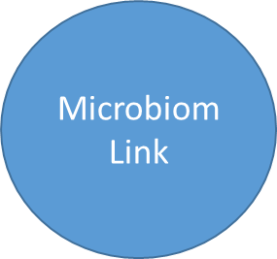
Center
for
Hologenomics
Clinical
Studies
(Co-Evolution)
www.globalbugs.com
WHAT
HOW
WHY
CLOCK
QUESTIONS

Slide 6
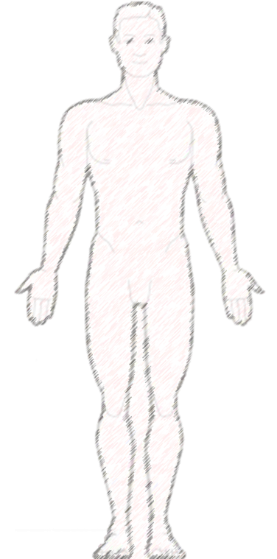

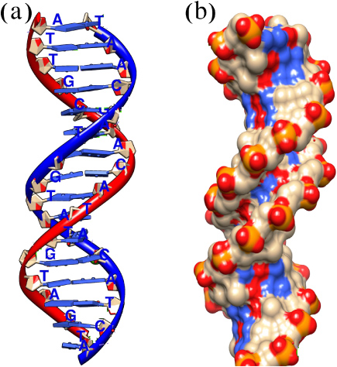
Self-Concept:
Alter Who We Are
Human
Microbiota
Microbes Matter
A / B / O
Blood Group
Phyla / Family
Enterotype
I, II, III
Siddhartha Mukherjee
The Emperor of all Maladies: A Biography of Cancer
Pulitzer Prize

Slide 7
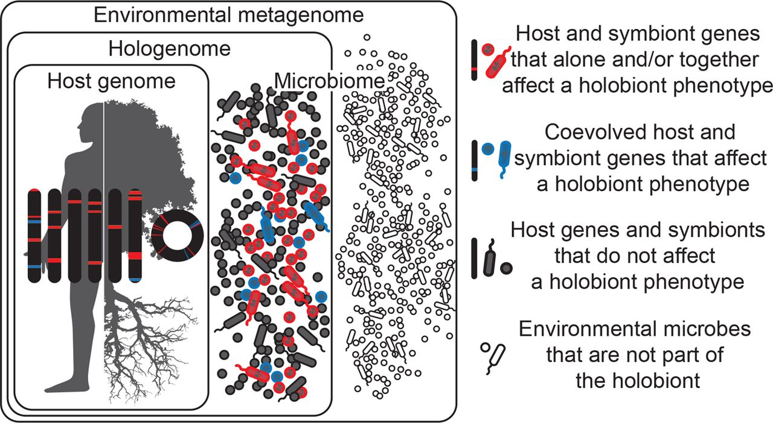

Holobionts are entities comprised of the host and all of its symbiotic microbes, including those which affect the holobiont’s phenotype and have coevolved with the host (blue), those which affect the holobiont’s phenotype but have not coevolved with the host (red), and those which do not affect the holobiont’s phenotype at all (gray).
Kevin R. Theis et al. mSystems 2016;1:e00028-16
Notes:
Holobionts are entities comprised of the host and all of its symbiotic microbes, including those which affect the holobiont’s phenotype and have coevolved with the host (blue), those which affect the holobiont’s phenotype but have not coevolved with the host (red), and those which do not affect the holobiont’s phenotype at all (gray). Microbes may be transmitted vertically or horizontally, may be acquired from the environment, and can be constant or inconstant in the host. Therefore, holobiont phenotypes can change in time and space as microbes come into and out of the holobiont. Microbes in the environment are not part of the holobiont (white). Hologenomes then encompass the genomes of the host and all of its microbes at any given time point, with individual genomes and genes falling into the same three functional categories of blue, red, and gray. Holobionts and hologenomes are entities, whereas coevolution or the evolution of host-symbiont interactions are processes.

Slide 8
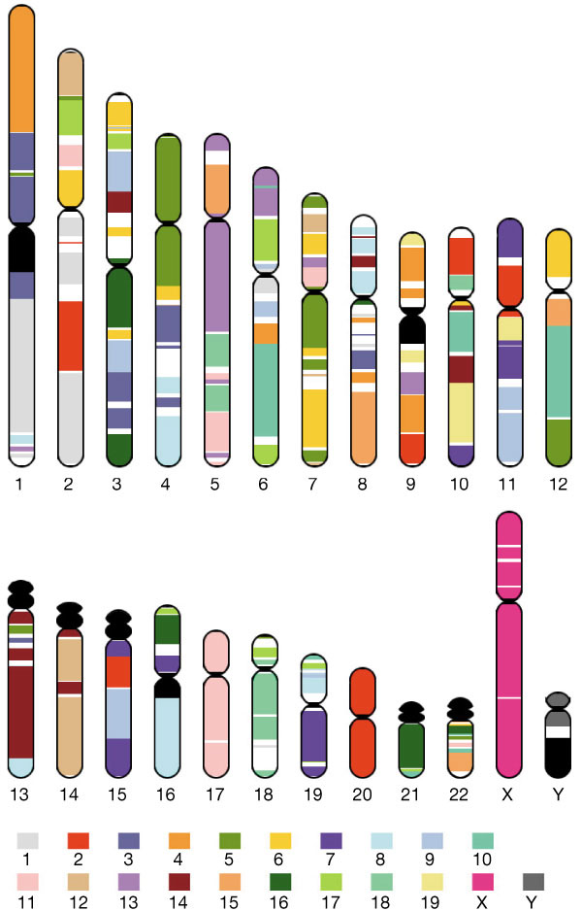
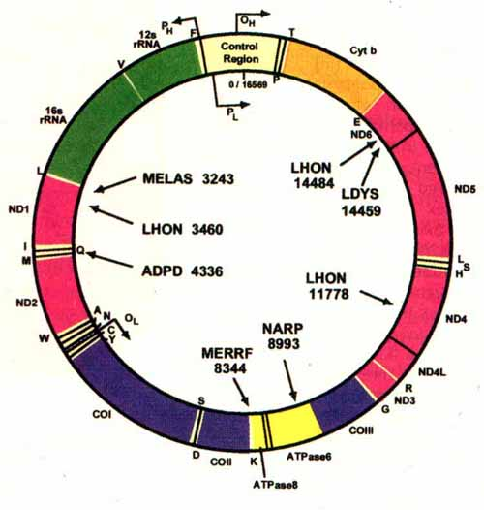

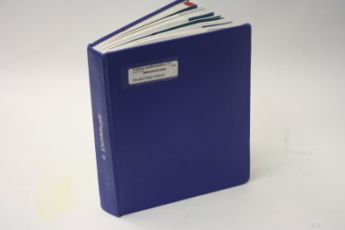
The Human vs. Bacterial Genomic Libraries
Human
Microbes
10^12 Eukaryotic Cells
10^14 Prokaryotic Cells
Cohabitation
INTELLEGENT
SYMBIOSIS
FACTS
23,000 Genes
8,000,000 Genes
25 year generation time
20 minutes generation time
Notes:
8

Slide 9
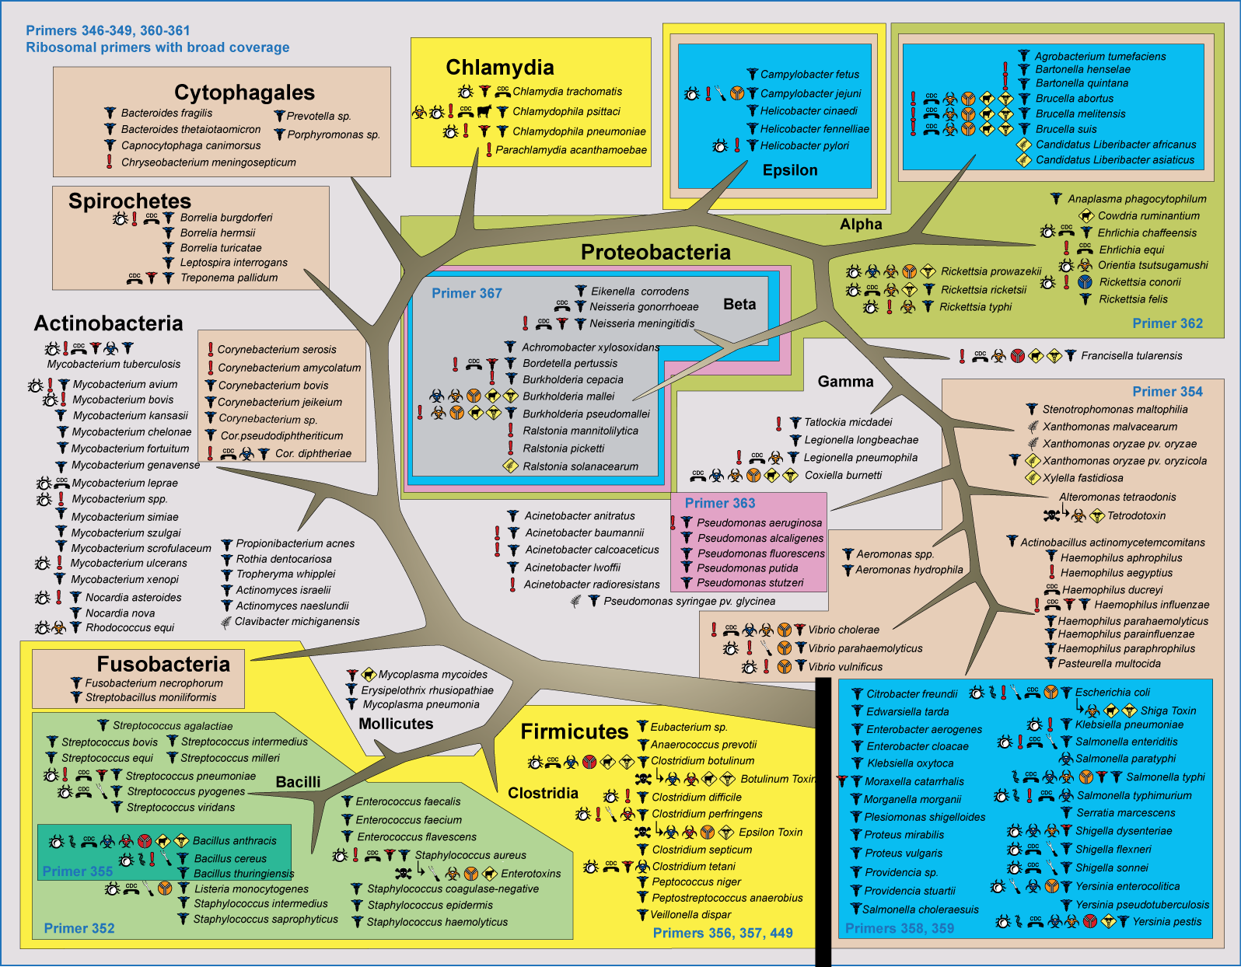
Life
Domain
Kingdom
Phylum
Class
Order
Family
Genus
Species
TAXONOMY
Phylum vs. Species
Animal
Plant
Procaryotes
100
10
6
Acintobacteria
Bacteroidetes
Firmicutes
Proteobacteria
Cyanobacteria
Fusobacteria
10,000 species

Slide 10
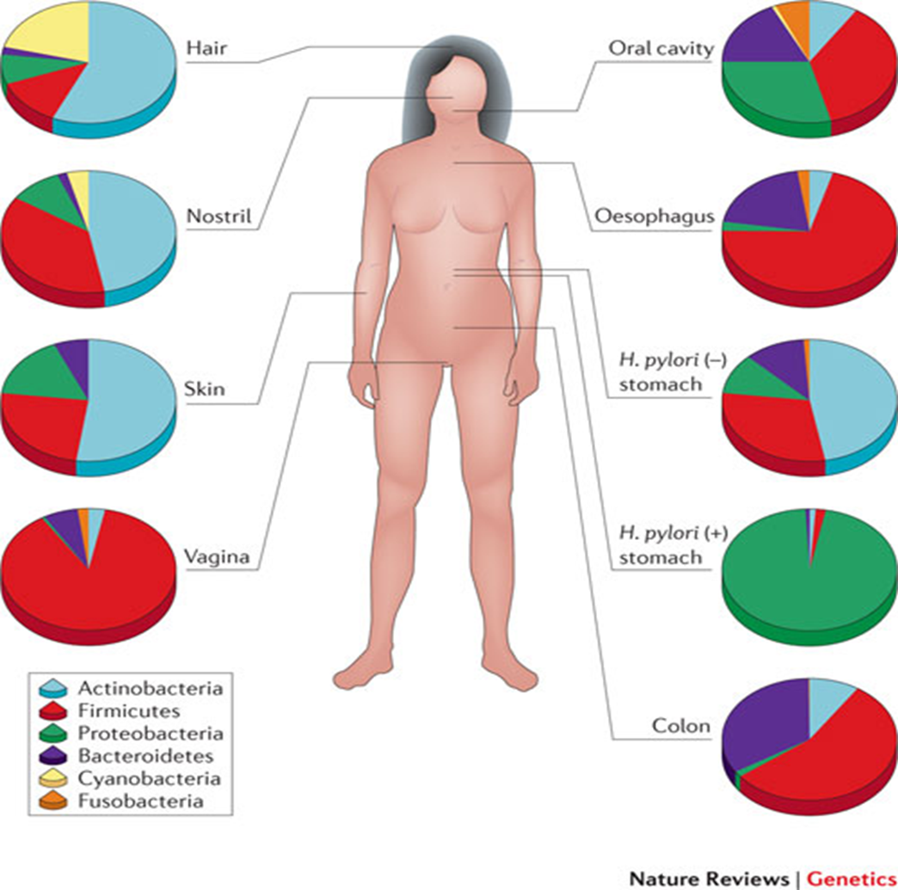
WHO WE ARE BY PHYLA
BENEFICAL MICROBES AS
DUAL CITIZENSHIP

Slide 11


II. “WHAT” AND “WHO” ARE BENEFICAL MICROBES?
Definitions: What??
Multiple Types (Search, Help and Destroy)
Characteristics highlighting Biofilms (BF) as Core
Definitions: Who??
“WHY”??
Fungi: The unrecognized “mycobiota”
STOWE, MT. MANSFIELD,
SMUGGLERS NOTCH SKI AREAS
VERMONT

Slide 12
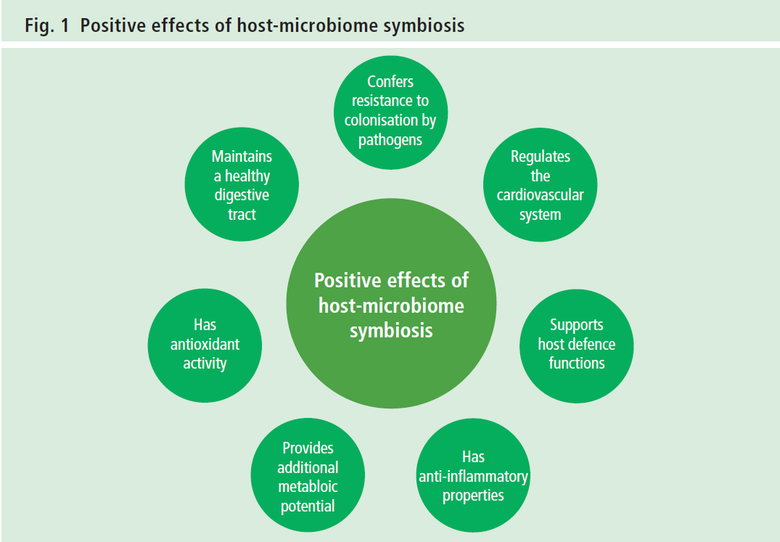
DEFINITION: Health
“Provide benefit to host
in a meaningful way recognizing there is a
SHARED benefit”
“INTELLEGENT SYMBIOSIS”
Ref.

Slide 13
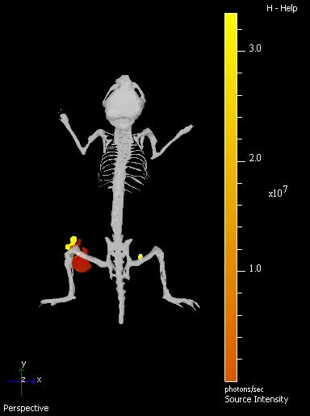

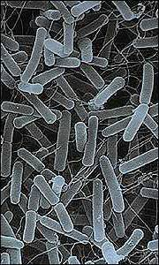
Bifidobacterium used in
Bladder Tumor
recognition
BENEFICAL MICROBES IN Medicine and Dentistry: Types
THERAPEUTIC (RX)
REPLACEMENT
PREDATORY
NEUROBIOTIC
HOMING/Detection
SIGNALING (Bio-Sensors)
IMMUNOMODULATING
TUMOR MODELING (JGT)
Salmonella Treatment for Cancer
TAPET (Tumor Amplified Protein Expression Therapy

Slide 14
Inhibit Adhesion
Inhibit Growth
Biosurfactants
Hydrogen Peroxide
PLANKTONIC
Lactobacillus Cell
Bifidobacterium
BAD BACTERIA????
Coaggregation Molecules
Acids
Bacteriocins
Determines colonization of other microbes
Inhibit Growth

Slide 15
Biofilm
LANDSCAPE AND BIOGEOGAPHY
A primitive type of developmental biology in which spatial organization of the cells within the matrix optimizes the utilization of the nutritional resources available
An immobilized enzyme system in which the milieu and the enzyme activities are constantly changing and evolving to appropriate steady state.
The steady state can be radically altered by applying physical factors such as high sheer.
Biofilms have four Stages I, II, III, and IV
FUNGI: cross linking and eDNA
WHY? PERSISTANCE , RESILANCE AND DIVERSITY
Notes:
15

Slide 16
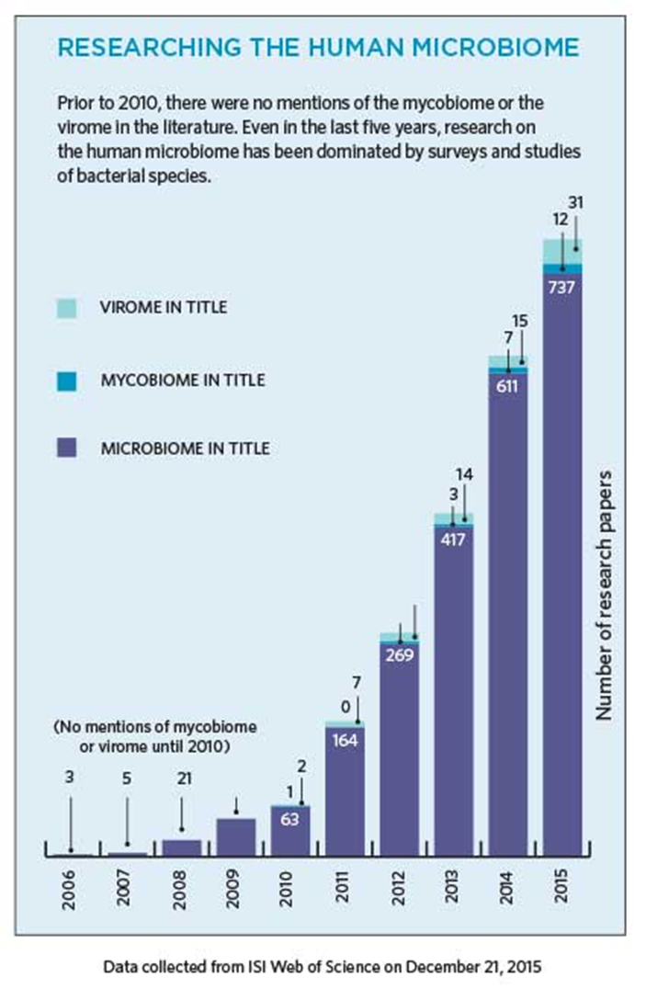
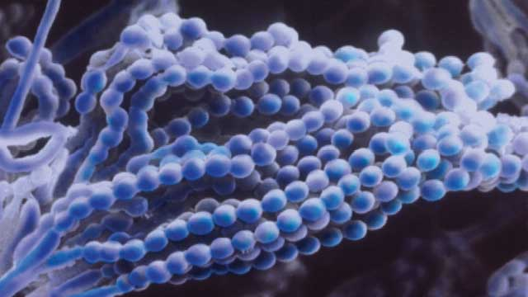
The Mycobiome: Missing
The largely overlooked resident fungal community plays a critical role in human health and disease. Ref. Ghammoun

Slide 17
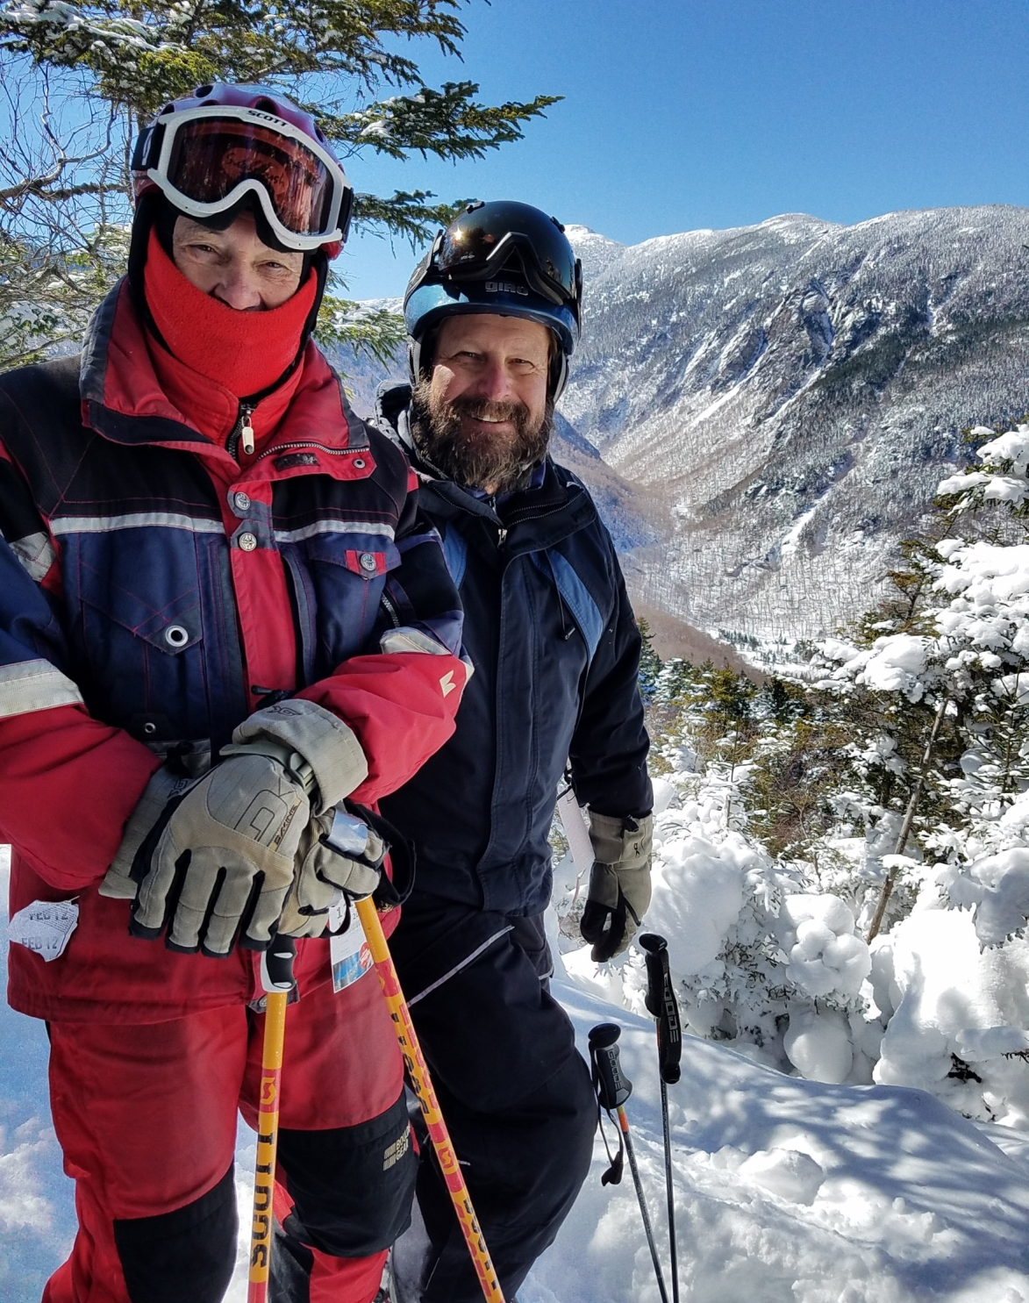

III. “HOW” DO BENEFICAL MICROBES WORK
The Quad: 4 Distinct Pathways
The “Axial” Connections: GUT, Skin and Vaginal
Mechanisms: Ying/Yang Hypothesis
SMUGGLERS NOTCH
SKI AREA
VERMONT

Slide 18
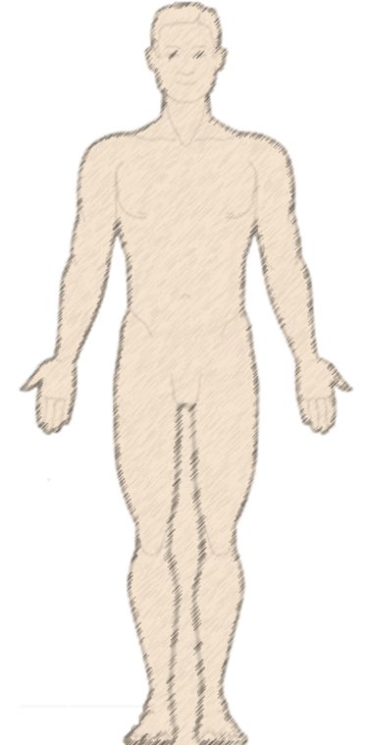
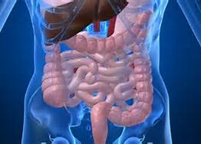

Rethinking Our Thoughts
Oral
Modulatory Dendritic Regulation
Skin
GUT
Gen

Slide 19

Distinct Signaling Pathways: the Quad
Direct Signals (Chemistry)
Bacterial-derived bi-products
interact with molecular
species and drive equation
B. Metabolic Signals (Bidirectiional)
Metformin impacts which folate metabolism which increases Methionine
Diet
Nutrition
D. Axenic Conditions
Different bacterial species
elicit specific transcriptional
responses
C. Species-specific signals
Low nutrient conditions drive community interaction and specific communicators'
The microbiota may mimic the activity of enzymes
Ref: Heintz, C. and W. Mair. Cell. Jan 30, 2014

Slide 20
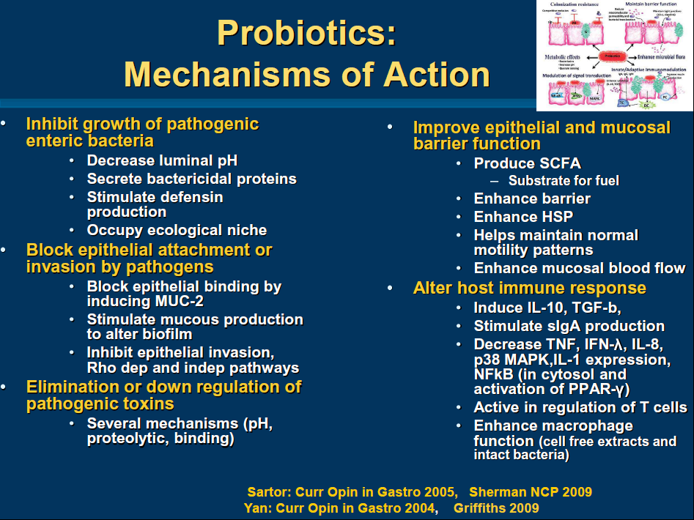

Slide 21
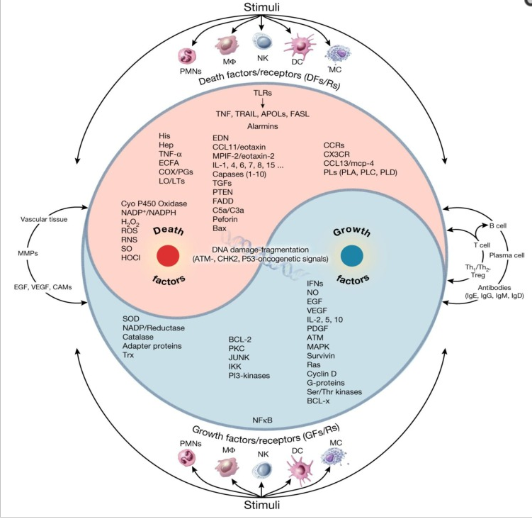
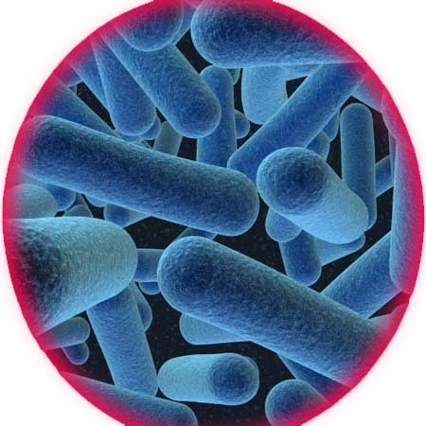
Implementaion of the Ying and Yang: Y/Y
Chronic Inflammation: Synergistic Interactions of Recruiting Macrophages (TAMs) and Eosinophils (Eos) with Host Mast Cells (MCs) and Tumorigenesis in CALTs. M-CSF, Suitable Biomarker for Cancer Diagnosis!
Mahin Khatami
Citation: Cancers 2014 Jan 27;6(1):297-322

Slide 22


IV. TARGETED HUMAN DISEASES OF BENEFICAL MICROBES
A Common path: Our Microbial Clock, birth to death
Endogenous: Metabolic Diseases
Exogenous: Infectious Diseases
Examples: Chronic wounds and Aging
Missing Microbiota: Collateral Damage of antibiotics
MAD RIVER SKI AREA
WAITSFIELD, VERMONT

Slide 23

ENDOGENOUS Diseases: Microbial Clock
Mother/Newborn
Autism/Asthma
Aged Care
Nursing Homes
55.5 – 75 years old
0 – 12 years old
Daycare Center
Dementia
AGE
Cognitive Skills
Co-adaptation
Microbiota/Mycobiota and
Human Cells
Cancer/Tumors
18.5 – 55 years old
Skin
Gut
Vaginal
Osteoper
12,5 – 18 Years old
Connecting multiple diseases through A single framework or underlying cause
Martin J. Blaser, M.D.
Ref.
Adult
Adolescent Diabetes
Obesity
Average age of U.S Population 37.5

Slide 24
ENDOGENOUS Diseases, Microbial Clock: Microbes and Phyla PRESENCE
Protobacteria
Bacteroidetes
55.5 – 75 years old
Bacteroidetes
Firmicutes
0 – 12 years old
AGE
Acintobacteria
Co-adaptation
Microbiota/Mycobiota and
Human Cells
Bacteroidetes
18.5 – 55 years old
Connecting multiple diseases through A single framework or underlying cause
Martin J. Blaser, M.D.
Acintobacteria
12,5 – 18 Years old
Firmicutes
Firmicutes
Protobacteria
Average age of U.S Population 37.5
Bacteroidetes

Slide 25
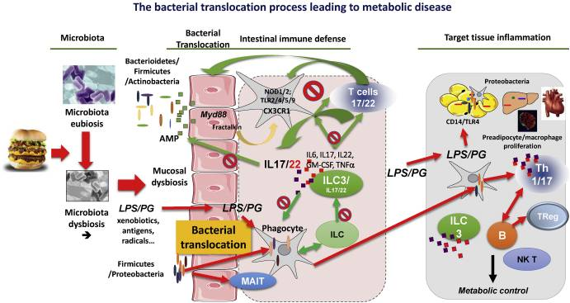
Y/Y
Gut microbiota and immune crosstalk in metabolic disease.
Burcelin R.
Mol Metab. 2016 Jun 6;5(9):771-81

Slide 26
MICROBIAL CLOCK: Endogenous Obesity
Bacterial communities with different proportion of bacteria in obese compared to lean
Greater representation of Firmicutes (+) and fewer Bacteroidetes(-)
After 52 weeks of diet-induced weight loss, the ratio of Bacteroidetes to Firmicutes approached a lean type profile
Metagenomic analysis- Enrichment in genes involved in energy extraction from food
Less energy in feces greater levels of short chain fatty acids (SCFAs) in the cecum
Luminal contents from ceca of obese or lean mice given to lean germ-free recipients, the mice receiving microbes from obese donors gained more weight over a 2-week period than recipients of the lean microbes despite equal food intake
REF. Ley RE et al. Proc Natl Acad Sci. 2005.
Turnbaugh P et al. Nature 2006.
Duncan et al. Int J Obes. 2008
Notes:
Obese individual- more efficient in converting food to usable energy an din storing this energy in fat than lean individulas

Slide 27
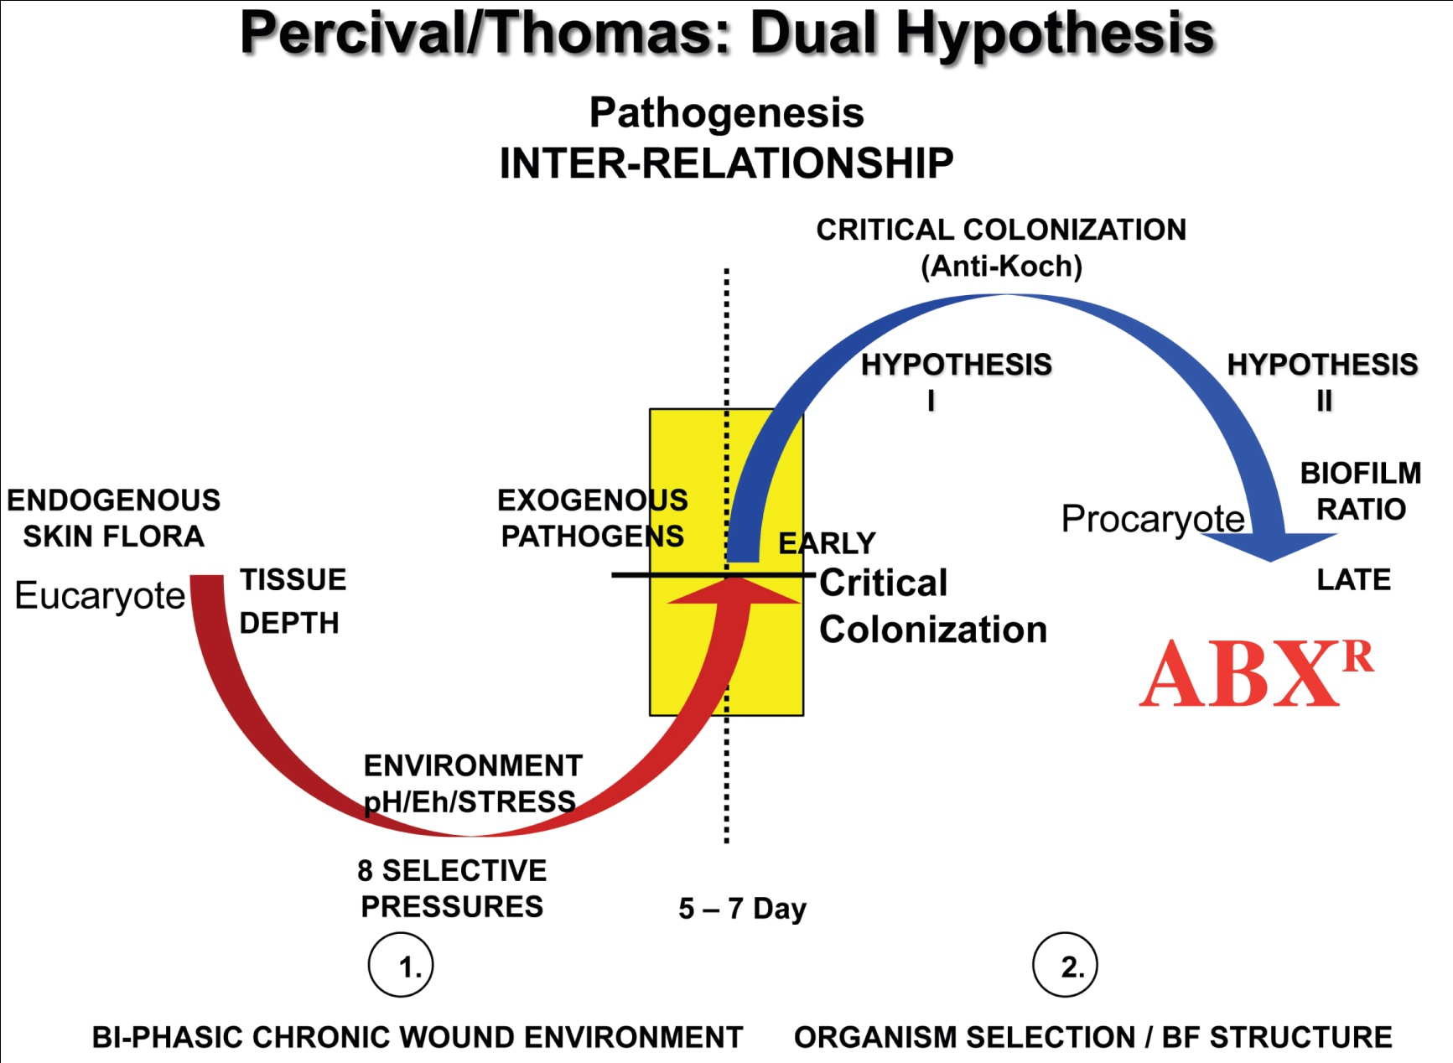
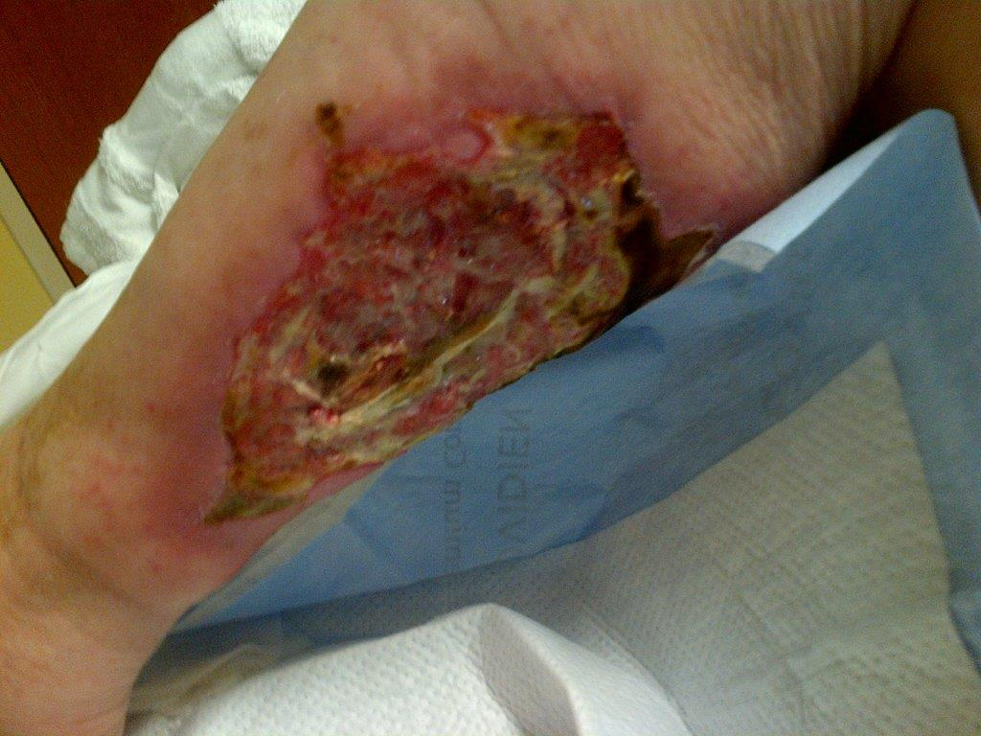
CHRONIC WOUNDS
EXOGENOUS “DISRUPTION/RECONSTRUCTION”

Slide 28
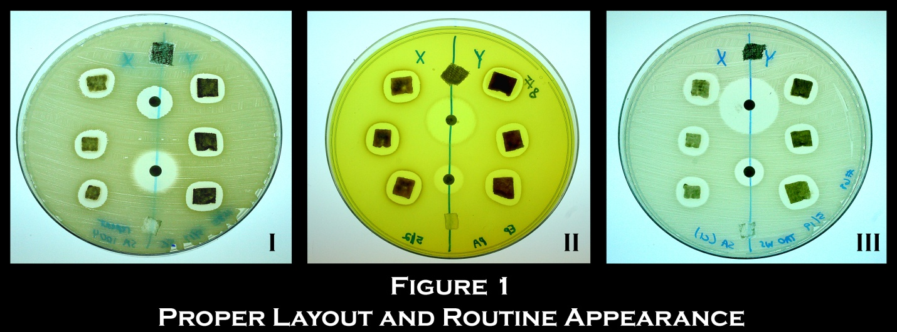
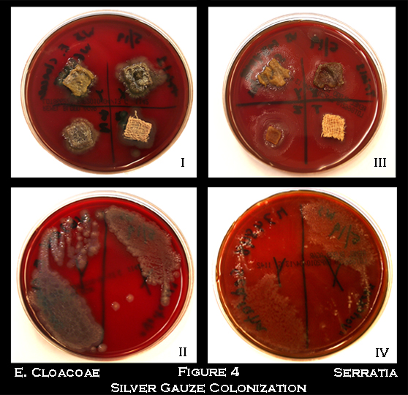
Integrating Biofilm (BF) and Planktonic (P) Transmission IN WOUNDS Ping-Pong” Pathogenesis “
ABIOTIC
Eh
pH
O₂
Dressing
11
BF
Nutrient
Supply
&
Stress
Planktonic
Planktonic
BF
H₂
2
Wound Bed
BIOTIC

Slide 29
Tailoring – Comprehensive Wound Care Reestablishing Skin Microbiota/Mycobiota “Disruption / Reconstruction”
Debreidment and Suctioning
Chlorihexidiene Scrub
RECONSTRUCTION PROBIOTICS
NIH 3 zones, skin microbiota PPT
DISRUPTION
Silver/Cooper/ Ceragenins Contour Fitting Dressing
pH and Eh Maintenance

Slide 30
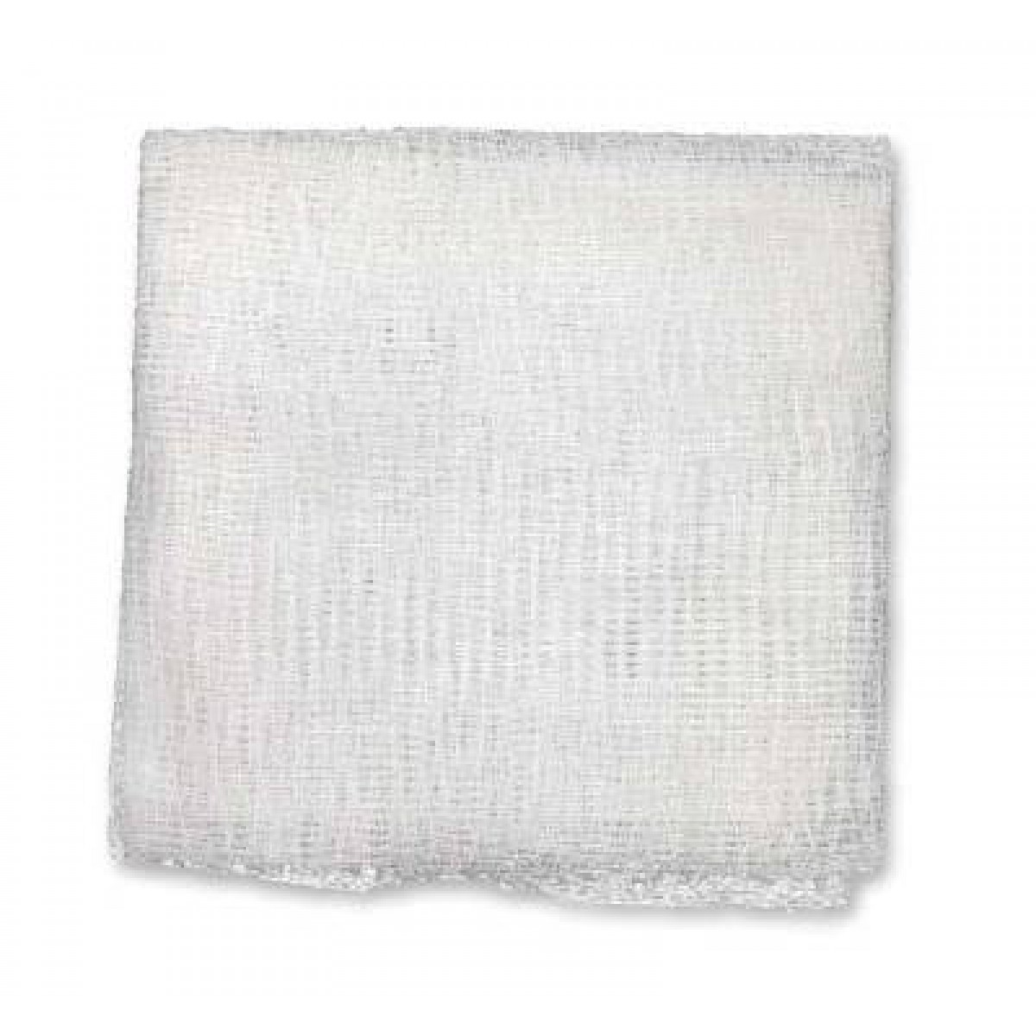
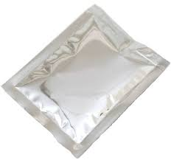
Intellectually Designed Gauzes 4 Es with Education (5) (Bac-2-Health/Part-4-Life)
Ecologically Sound (Patient)
Environmentally Friendly (Globe)
Engineered Intelligently (X-Y-Z)
Contour Fitting via 3-D
Economically Feasible
SMarT : I, II, III
SMarT I
S=Synbiotic (Pre/Probiotic)
M=Mixed species, biofilm, BOTH FUNGI and Bacteria
Sacchromyces bulardi
ar= 0 antibiotic tolerance
T=Theray incorporating
Antibiotic stewardship

Slide 31
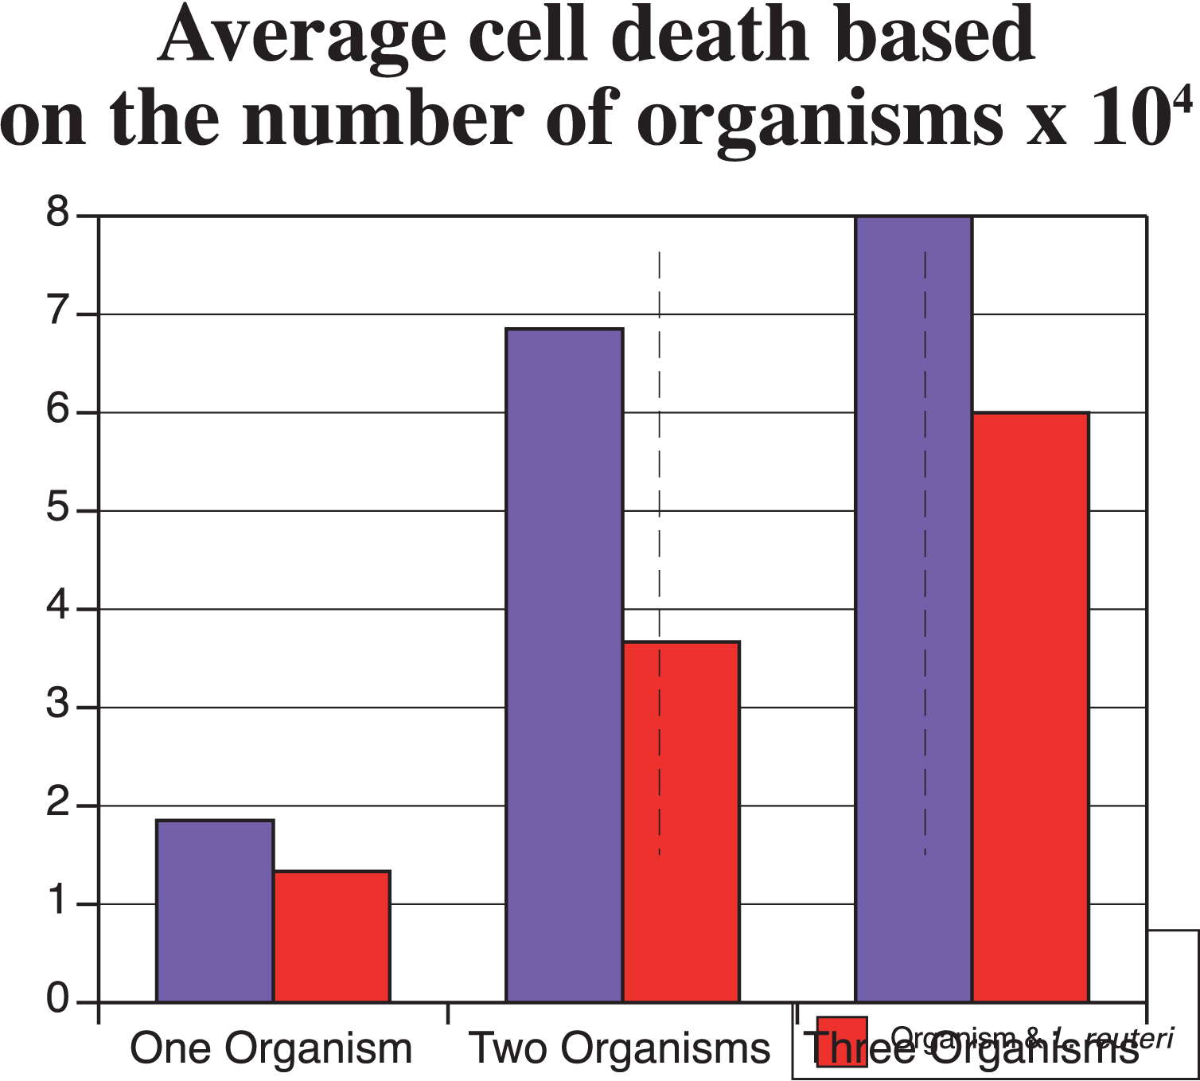
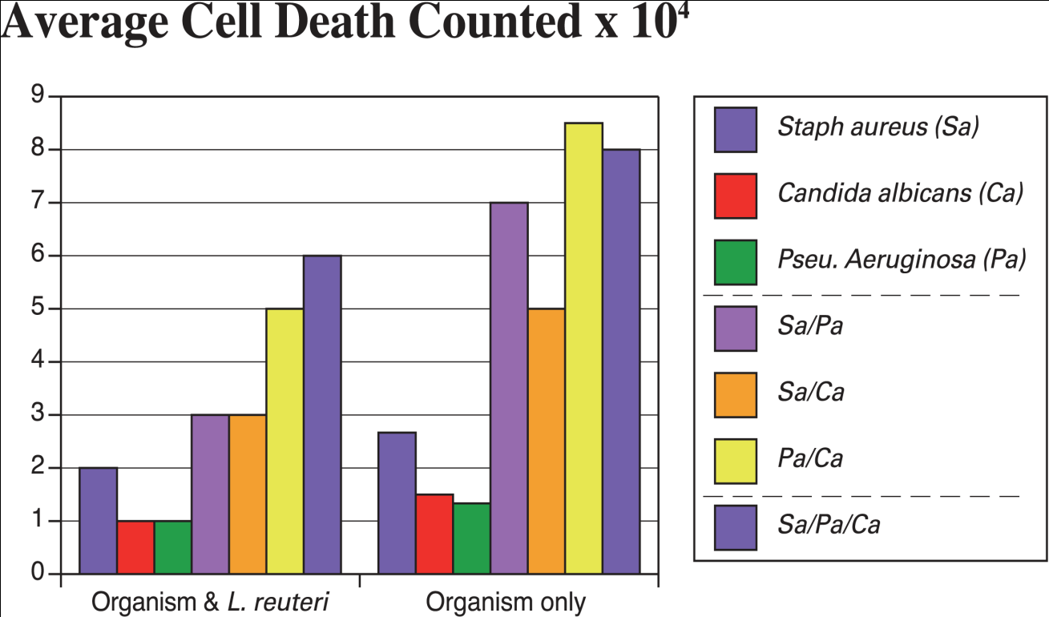
Results SMarT I
METHOD:

Slide 32
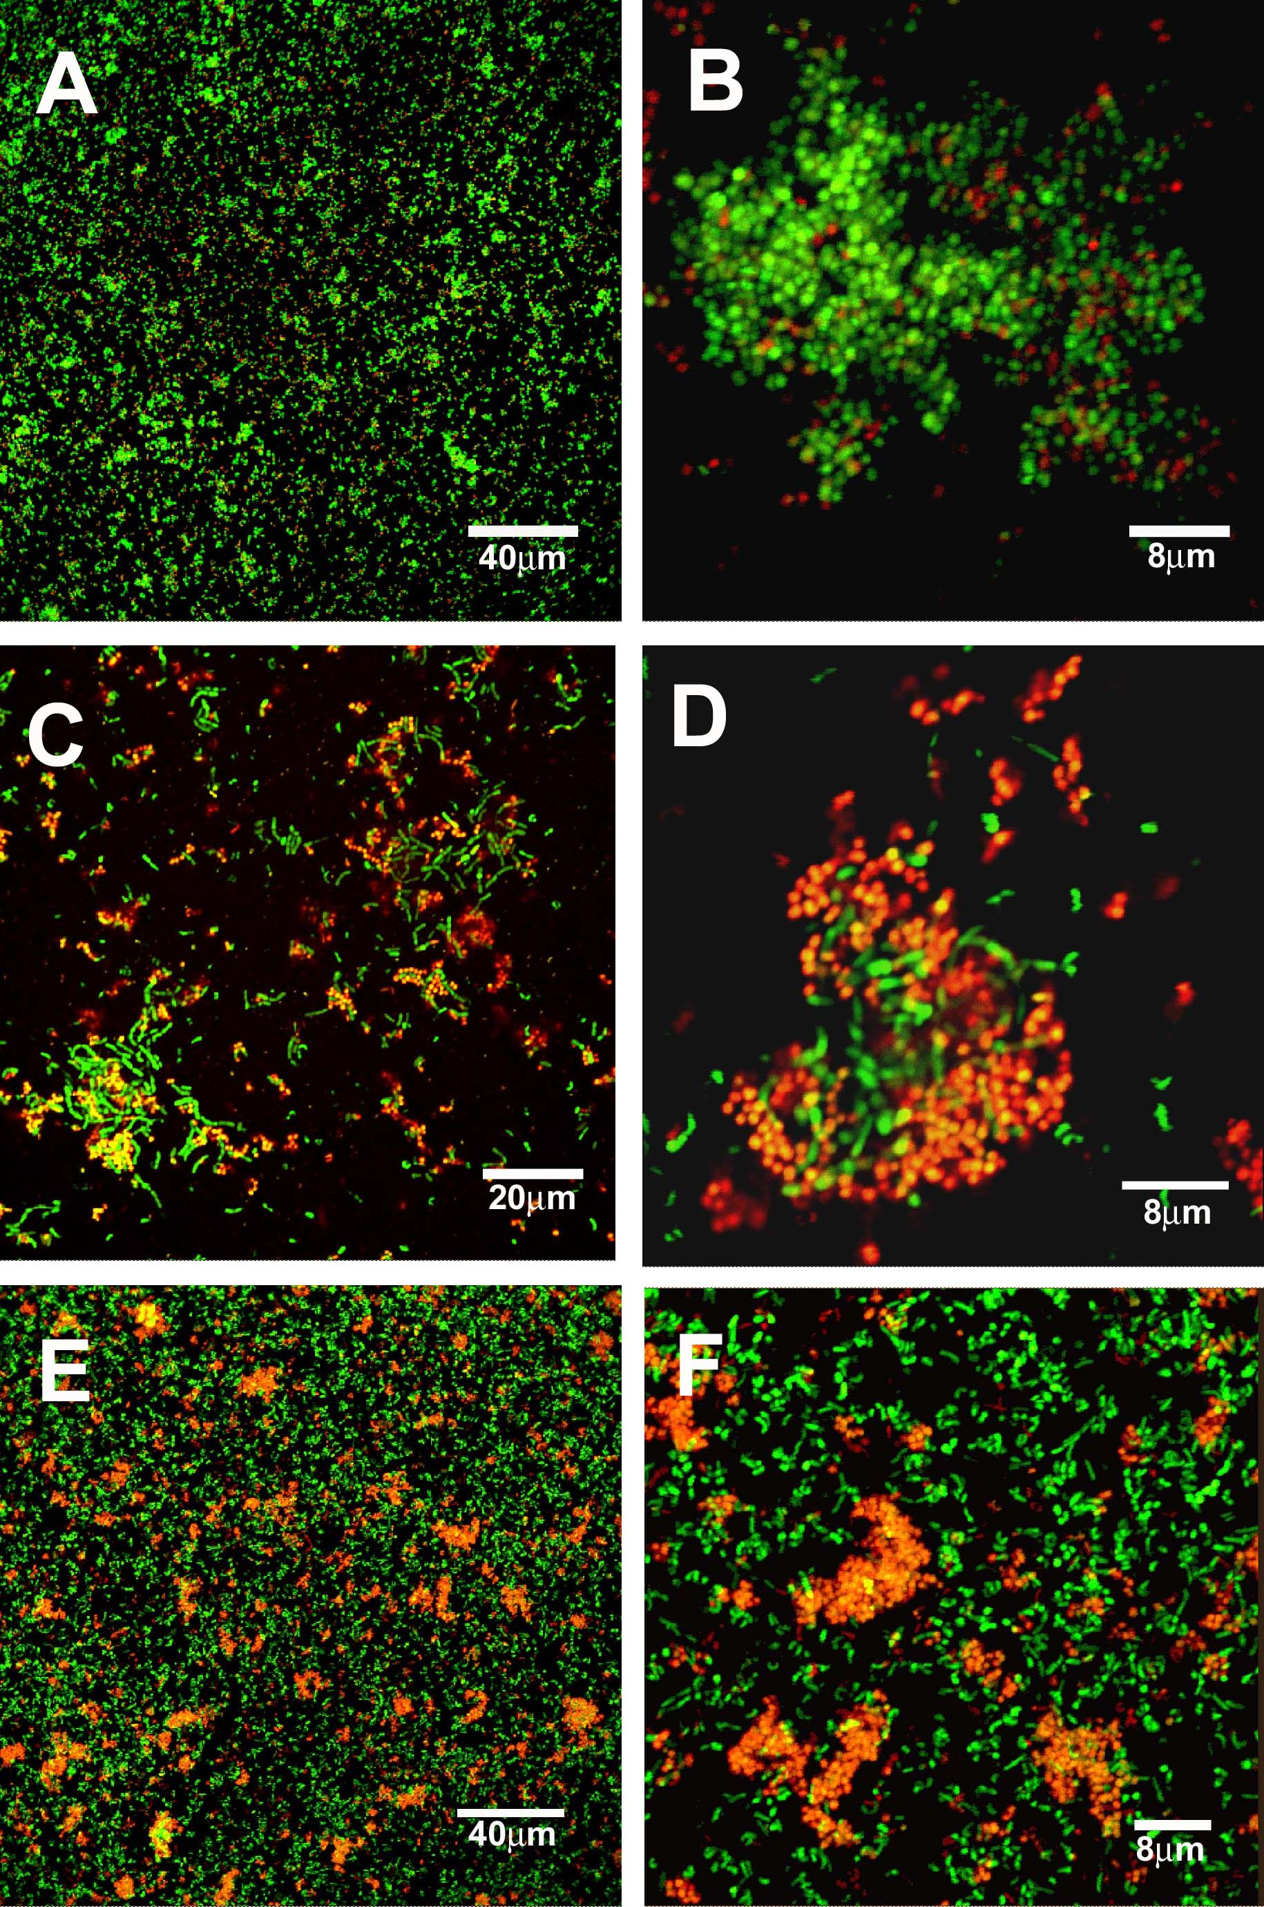
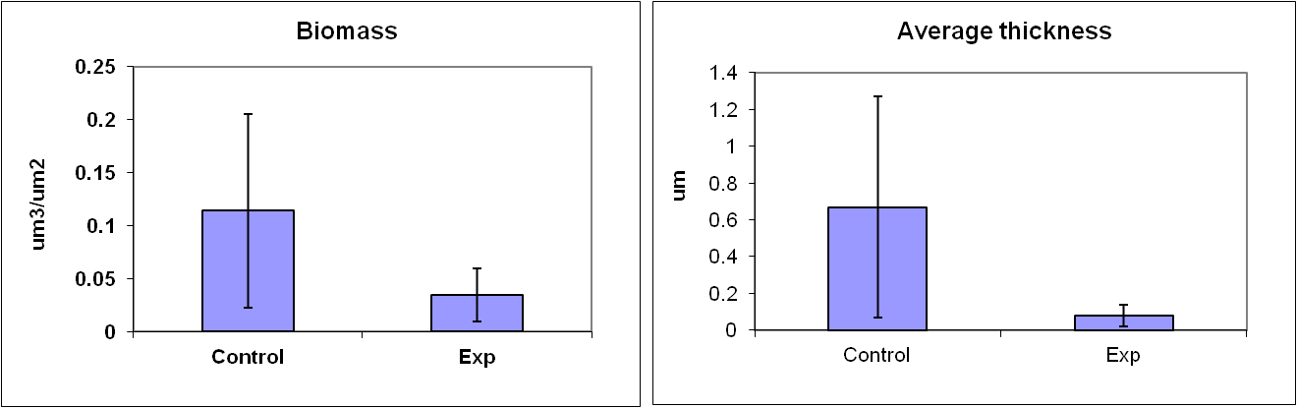
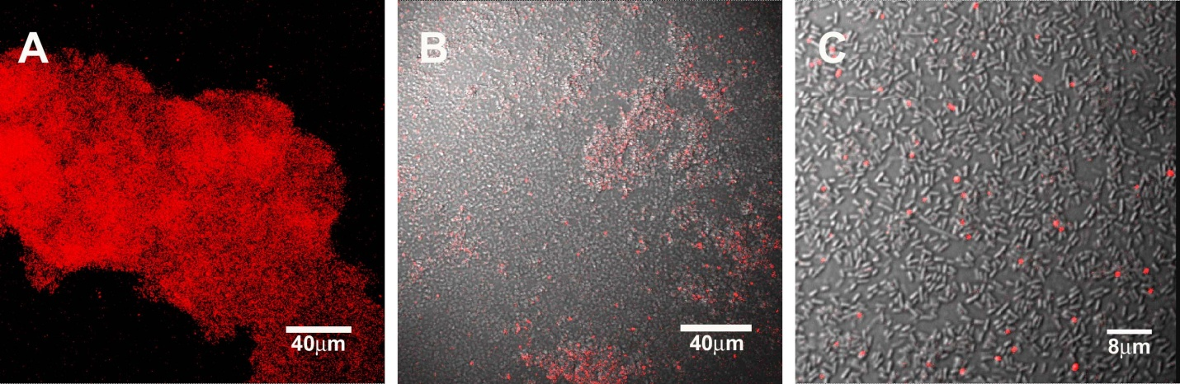
SMarT ER II: Staph aureus Biofilm and LR probiotic RX:FISH
Live Dead Stain : MRSA and
Probiotic Pool RX
METHOD

Slide 33
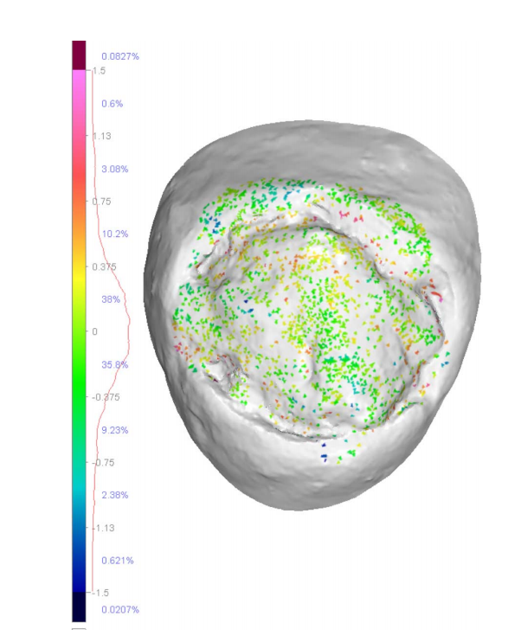
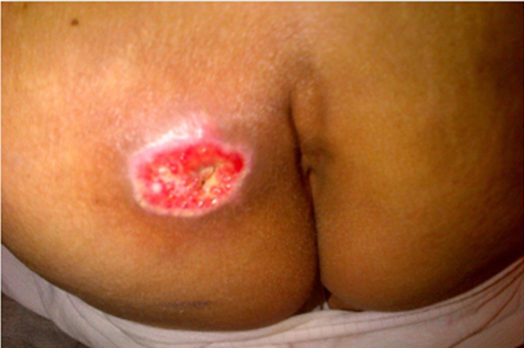


SMarT EST III
Three Dimensional Assessment of Skin Wounds
Creating Volumetric (X, Y, Z) Dimensions
for 3 D Printing (Bio Bandage)
Y
Z
X

Slide 34
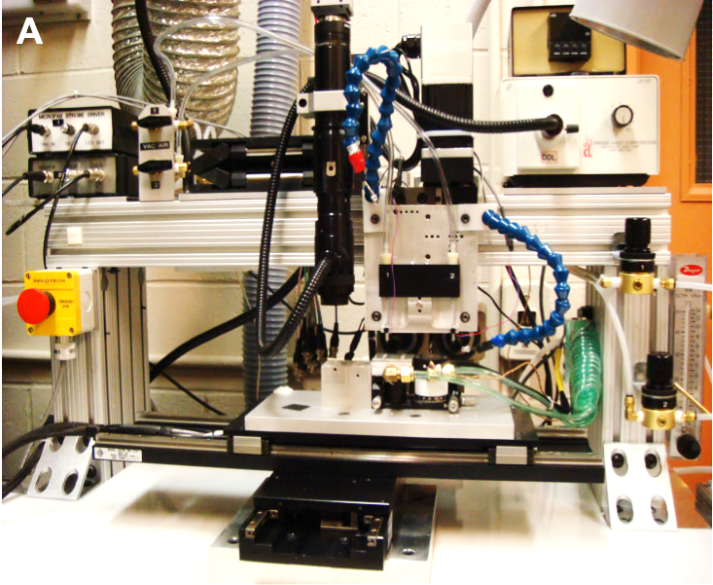
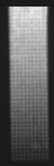
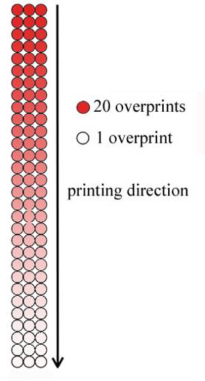
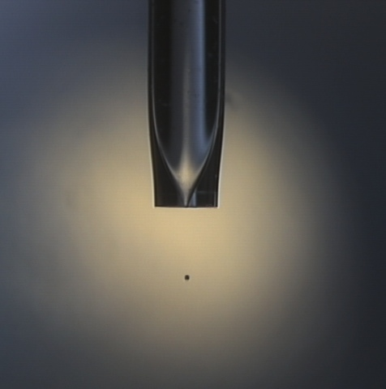
SMarT EST IIII . WOUND CONTOUR Inkjet-Based Bioprinting with gradient concentrations (and BioSensors)
Y/Y
sssssssssss
Ref.
Ref Cited
Accuracy : 0.2μm
Separation : 80μm
Drop dia. : 42μm
Drop volume : 39pl
Conc. / drop : 1.9pg
Concentration-modulated using an overprinting strategy
30 μm
nozzle
39pl
drop
Notes:
The bioprinting technology uses a piezoelectric inkjet coupled with a X-Y-Z stage.
Not only can we spatially control the delivery of signaling molecules, we can also deliver these signaling molecules at physiological concentrations.
With a pore size of 30microns, we are able to print at 1.9 pg/drop with an accuracy of 0.2μm.
By controlling the repetitions, which we call overprints, we can control the delivery dose.
By printing on a substrate such as DermaMatrix, we can assure the in vivo sequestration is spatially confined.

Slide 35
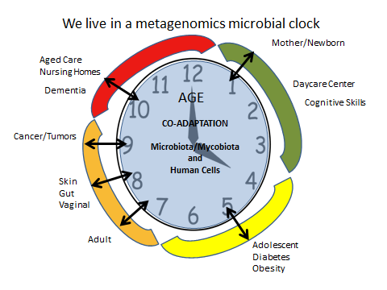

Microbial Clock: AGING. A New Disease
EXOGENOUS
Dementia
COPD
Autism
Asthma
Asthma / Autism
Brain
Lung
BRAIN
CRC
?
142 / 100
Osteo
Ref. NIH
Zhavoronkov and
Moskalev .2016
Front Genet. 7:17
Alzheimer’sDisease (AD)

Slide 36
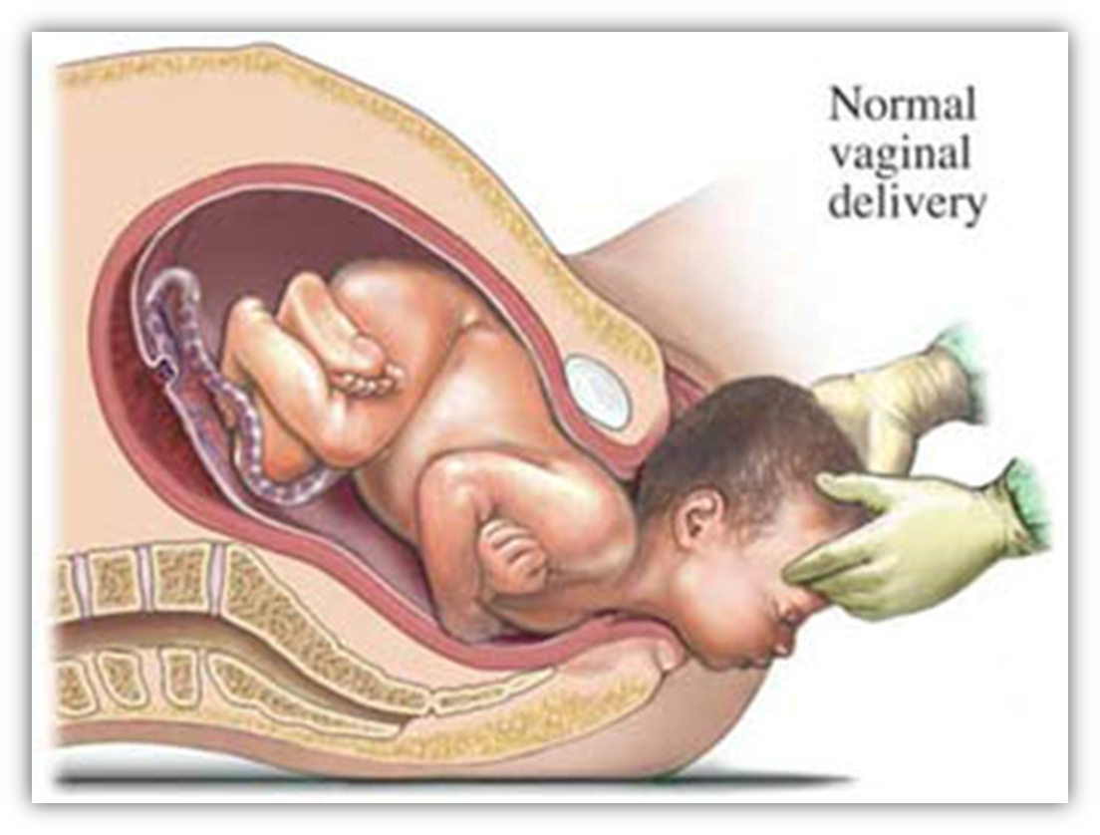
Linking Asthma / Autism to Delivery and Antibiotic (on-going)
New
Microbiota
New Born
Mother delivers twice / Dual Citizenship
Untoward Consequences / Collatoral Damage of Antibiotics

Slide 37


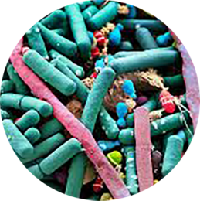
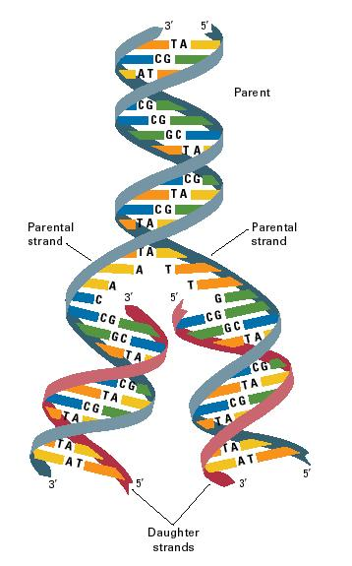
Theories of Aging (1 AND 2) AND MICROBIOTA(3): Linking Hologenomic Evolution AND Time
1
2
HOST
SLOW
ENVIROMENT
Programmed Death based
on free radical AND fixed
schedule
vs.
Damaged-based emphasizing
cellular breakdown and
Interaction with ENVIROMENT
IMMUNO SENESCENCE
3
GLOBE, animals and
anti infectives
Microbes
FAST

Slide 38
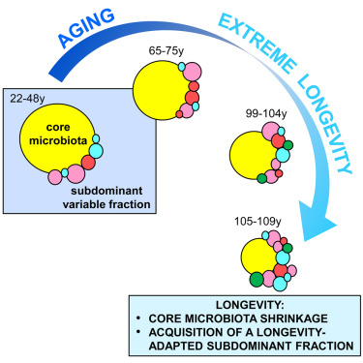
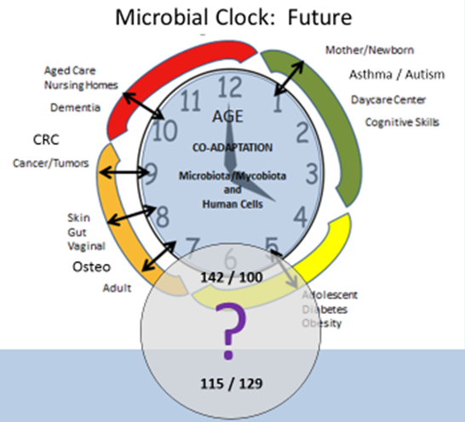
Gut Microbiota and Extreme Longevity
Ref: Biagi et al., 2016, Current Biology 26, 1480–1485 June 6, 2016

Slide 39
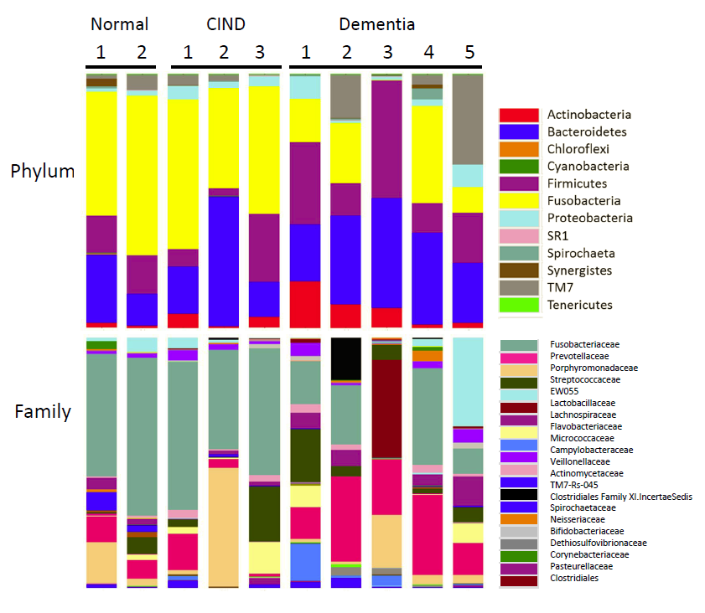
Plaque Sample Analysis for Cognitive Behavior
Ref.

Slide 40
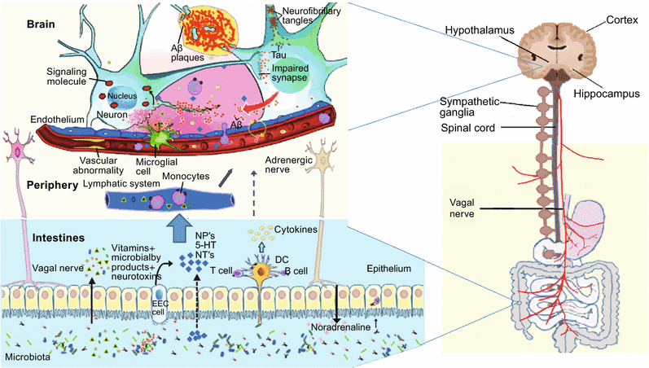
Human GUT microbiota: The links with dementia development
Schematic of key regulatory cells in pathogenesis of Alzheimer’s Disease
Y/Y
Protein & Cell February 2017, Volume 8, Issue 2, pp 90–102 Rashad Alkasir

Slide 41
The GUT Brain link in AD (RED) and ADS (GREEN):
The Microbial Clock
Is bi-directional neurohumoral communication system
Neurodevelopmental deficits are frequently associated
with GUT symptoms and GUT dysbiosis
Modulation of the GUT microbiota is a promising
strategy (Probiotics)
Bacterial products amplify activity thru cytokine
release from mucosal immune cells , through
release of GUT hormones
Ying/Yang Hypothesis central theme, early and late

Slide 42
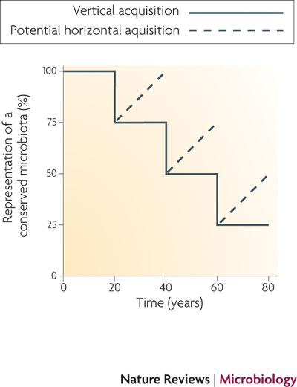
Human Microbiome The Disappearing Microbiome
Increase in allergic disease and asthma is a consequence of the disappearing microbiota- loss of our ancestral microorganisms
Cleaner water, smaller families, reduced breastfeeding, widespread antibiotic use
Is our cleanliness making us sick?
PROBIOTIC-------
Blaser et al. Nat. Rev. Microbiol. 2009

Slide 43
We live in a metagenomics microbial clock: MISSING
AGED MICROBIOTA
Mother/Newborn
Autism/Asthma
INFANT MICROBIOTA
Aged Care
Nursing Homes
Daycare Center
Dementia
AGE
Cognitive Skills
Co-adaptation
Microbiota/Mycobiota and
Human Cells
Cancer/Tumors
Firmicutes, Bifidobacteria
Clostridium cluster XIV
Faecalibacterium Prausnitzii
Blautia coccoides-Eubacterium rectal
Skin
Gut
Vaginal
Osteoper
Adult
Adolescent Diabetes
Obesity

Slide 44
WARNINGS of the ENVIROMENT (3): BEYOND MDR
“Antibiotics have been recently associated with
chronic diseases highlighting aging and a microbial
clock: Newborn and Childhood diseases, asthma
and autism, particularly, are untoward
consequences. In adolescence, mounting studies
of diabetes and obesity, highlight antibiotics as
suggested co - factors, amplifiers or precipitators and
should be used only when value of therapy has been
validated. For the Aged, antibiotics are potential co -factors in colorectal cancer, stomach cancers
(H pylori)..”
John G Thomas

Slide 45


V. APPLICATIONS OF BENEFICAL MICROBES (Therapeutic Bacteria/pre and probiotics) via EDUCATION
Probiotics: Replacement/Restorative Microbiology or Therapeutic Bacteria
“Organ Transplants”
Computer Assisted Decision Support: Bac-2-health and Part-4-Life
Phylo-Type: A,B,C,D
“Precision” or “Personalized Medicine”: Beneficial Microbes Future
Integration with Artificial Intelligence Platforms
SYNBIOSIS: PRE/PROBIOTIC
MAD RIVER SKI AREA

Slide 46







Slide 47

Tracking & Linking Disease by 6 Global Regions: The WHO Gradient - Probiotics
2.
Europe
Fastest 45%
Germany + UK
Children GI
Dental
Japan/ Asia-Pacific 2nd Fastest
GI
Immunity
1.
6.
US is $11.3 bill to $15 bill in 2013
Dental Caries
4.
5.
3.
30% of Population uses Probiotics
$85.7 bill (Global)
Growing $at least 15%/yr
(Doubling since 1993)
3. African Region
5. South-East Asia Region
4. Eastern Mediterranean Region
1. Region of the Americas
2. European Region
6. Western Pacific Region
http://www.who.int/about/regions/en/index.html

Slide 48

Organ Systems:
6 + 1 (normal flora)
Microbiota/Mycobiota = An Organ System
Stewardship of Normal Flora

Slide 49


ORGAN TRANSPLANT as RESTORATIVE MICROBIOLOGY
MINI… Periodontal diseases
Reduction of Strep mutans using
Lactobacillus reuteri Prodentis strain
MAXI…C. difficile. Enteral replacement
Family or synthetic.
Missing: Bacteroieds, Lachnospiraceae,
Ruminococcaceae ……
Produce Butyrate, which inhibits C. diff.

Slide 50


Bac 2 Health/Partners 4 Life: Computer assisted Educational
Decision Tree(Support) www.globalbugs.com/Probiotic solutions
ADD 3 Dental Students
User (A,Public and B, Professional)
Condition / Disease (11)
Probiotics (21)
Microbes (22)
Abstracts (310)
Manuscript/Abstract (310)
Grading(I-VII)/Strength ===----
Authors / Key Words
Smart phone compatible
Bac 2 Hea Partners 4 Life
310 Articles

Slide 51



Interactive Web-Based Probiotics Database
Public and Healthcare Professionals
Neurological- 1 Article
- Brain activity
AGING
35 Articles
-cognition
-dementia
-AD
-probiotics
Endocrine – 12 Articles
- Diabetes
- Gestational diabetes
Oral - 75 Articles
- Candida albicans
- Dental plaque
- Gingivitis
- Perio pathogens
- Strep. mutans
- Halitosis
Immune 35 Articles
- Immune regulation
- Allergies
- Allergic Rhinitis
- Wound Therapy
Cardiovascular- 25 Articles
- Obesity
- Cholesterol
Respiratory – 3 Articles
- Cystic Fibrosis
- Ventilator Pneumonia
- Common Cold
310
Articles
WOUNDS
34 Articles
-tissue engineering
-biosensors
-chronic
-probiotics
Gastrointestinal – 110 Articles
- Antibiotic Associated Diarrhea
- Acute Gastritis
- Blastocytis hominis
- Candida Colonization
- Colon Cancer
- Celiac
- Clostridium difficle
- Crohn’s Disease
- Constipation
- Diarrhea
- Helicobacter pylori
- IBS
- Liver Disease
- Neonatal Enterocolitis
- Pouchitis
- Regulation of microflora
Skin – 15 Articles
- Eczema
- Atopic dermatitis
Joint Health – 2 Article
- Arthritis
Female reproduction – 20 Articles
- Bacterial Vaginosis
- Vaginal Health
- Yeast infection

Slide 52

Articles | Condition | Study | Strength | Microbe | Probiotic
W - 1 | TAXONOMY | REVIEW(IV) | A | MULTIPLE | ---------
W - 2 | BIOFILMS | REVIEW(IV) | A | MULTIPLE | ---------
W - 3 | MYCOBIOM | REVIEW | B | MULTIPLE | ---------
W - 5 | 3-D-MODEL | REVIEW(IV) | B | --------- | ---------
W - 12 | CORE GENE | IV | A | --------- | ---------
W - 21 | PROBIOTICS | REVIEW | B | --------- | ---------
W-X W-Y | HEALTH HOMEOSTA | HYPOTHESIS REVIEW | A A | HUMAN T-CELL MIG | --------- ---------
AGING Theories/Probiotics: Cross Section of Published Articles
Articles | Condition | Study | Strength | Microbe | Probiotic
A - 2 | AGING | REVIEW (IV) | B | MULTIPLE | MULTIPLE
A - 5 | AGING | REVIEW (IV) | A | MULTIPLE | MULTIPLE
A - 6 | AGING | REVIEW | A | -------- | --------
A - 7 | AGING | ANIMAL | B | GUT | --------
A - 11 | AGING | REVIEW | C | CDAD | --------
A - 23 | YING/YANG | HYPOTHESIS | A | HUMAN | --------
A – X A-Y | PRECISION AGING | HYPOTHESIS INFLAMAT | A A | HUMAN HUMAN | -------- --------
Articles | Condition | Study | Strength | Microbe | Probiotic
A - 21 | HEALTHY AG | REVIEW | B | MULTIPLE | MULTIPLE
A - 24 | AGING | REVIEW | C | --------- | BIFIDO
A - 26 | GUT | ANTI-INFLA | B | --------- | SMART
A - 27 | AD | CLINICAL(III) | B | COCKTAIL | DRINK
A - 28 | AD | CLINICAL(III) | B | 4 | MILK
A - 30 | HEALTHY AG | REVIEW | C | --------- | ---------
A- NEW

Slide 53


Articles | Condition | Study | Strength | Microbe | Probiotic
W - 1 | TAXONOMY | REVIEW(IV) | A | MULTIPLE | ---------
W - 2 | BIOFILMS | REVIEW(IV) | A | MULTIPLE | ---------
W - 3 | MYCOBIOM | REVIEW | B | MULTIPLE | ---------
W - 5 | 3-D-MODEL | REVIEW(IV) | B | --------- | ---------
W - 12 | CORE GENE | IV | A | --------- | ---------
W - 21 | PROBIOTICS | REVIEW | B | --------- | ---------
W-X W-Y | HEALTH HOMEOSTA | HYPOTHESIS REVIEW | A A | HUMAN T-CELL MIG | --------- ---------
WOUND Theories/Probiotics: Cross Section of Published Articles
Articles | Condition | Study | Strength | Microbe | Probiotic
W - 1 | TAXONOMY | REVIEW(IV) | A | MULTIPLE | ---------
W - 2 | BIOFILMS | REVIEW(IV) | A | MULTIPLE | ---------
W - 3 | MYCOBIOM | REVIEW | B | MULTIPLE | ---------
W - 5 | 3-D-MODEL | REVIEW(IV) | B | --------- | ---------
W - 12 | CORE GENE | IV | A | --------- | ---------
W - 21 | PROBIOTICS | REVIEW | B | --------- | ---------
W-X W-Y | HEALTH HOMEOSTA | HYPOTHESIS REVIEW | A A | HUMAN T-CELL MIG | --------- ---------
Articles | Condition | Study | Strength | Microbe | Probiotic
W - 7 | IMPAIRED | REVIEW(IV) | B | MULTIPLE | MULTIPLE
W - 10 | RESIS BUG | IN VITRO(III) | A | BIFIDO | SUPERNAT
W - 19 | INFECT WD | RABBIT(III) | A | LACTO | GAUZE
W - 20 | MRSA | REVIEW | B | MULTIPLE | MULTIPLE
W - 22 | INFECT BUR | CLINICAL TR | B | L PLANTAR | ANTI PA

Slide 54
“Precision” / Personalized Medicine: Non-oncologic
Prevention
Risk stratification of sub-population
B. Disease Diagnosis
Clinical variance and follow-up of disease progression
Diet
Nutrition
D. Nutrition
Individualized food recommendations in a multifactorial approach
C. Therapeutics
Microbiome driven personalized drug response and modification
Person Specific (Microbiota) Information. PSI
Ref. Zmora, N. et al. 2016. Taking it Personally: Personalized Utilization of Human Microbiome in Health and Disease.
Cell and Host Microbe. 19 (Jan 13):12-20

Slide 55
Microbial Clock: Composite Disease Signature
MATCHING PROBIOTICS
Decision Support
A. Disease
Phylo Type
A/B/C/D
B. Bacteria
Present
D. Fungi
LINKING COMPUTER SUPPORT
USING BAC-2-HEALTH DATA
AND AI
C. Bacteria
Missing
ABSTRACT PRESENTATIONS, Aging Society and International Medicine : The Trilogy.
1) Concept ( 2015); 2) Aging (2016) ; 3) Probiotics and Aging (2017)

Slide 56
ARTIFICAL INTELLEGENCE (AI):
Redesign Health Care (Adolescence 2007)
Human Disease algorithms and platforms: Clinical Disease Support Systems/Expert Systems
LARGE. Babylon Health(UK)/ Watson Health(USA)
SMALL. “Fungemia Risk factors: A Computer Based Model to Analyze at Risk Populations”
67% vs 77% diagnosis
Smart phones compatable
Infectious Disease algorithms
GIDEON (Global Infectious Disease and Epidemiology (ON LINE) Network)
DX/Epidemiology
Rx (Antibiotics)
Microbiology
FUTURE: RX Probiotics, as linking with Bac-2-Health and Partners -4-Life

Slide 57


VI. CONCLUSION
“We live in a Microbial World” emphasized by Hologenomic Co Evolution
Variety of microbes can be beneficial for a variety of human diseases diseases
Don’t TRASH YOUR MICROBIOTA/MYCOBIOTA
Profile Dual Transcriptomics in Disease: Study BOTH Macro and micro Holobiont
Unlearning the Learned
Marketing vs Medical Research
Importance to Clinical Laboratories
MAD RIVER SKI AREA
WAITSFIELD, VERMONT

Slide 58


Self-Concept:
Alter Who We Are
Human
Microbiota
Microbes Matter
A / B / O
Blood Group
Phyla / Family
Enterotype
I, II, III
Don’t Trash Your Microbiota/Mycobiota:STEWARDSHIP

Slide 59
UN-Learning the LEARNED: FUTURE
BENEFICAL MICROBES represent a unique opportunity with significant challenges, realizing a shared benefit of procaryotes and humans , unmasked by the HOLOGNEOMIC Theory, highlighting the massive genetic strength of the former.
PRESENCE Phyla/Family may be most important in defining health and disese , an extension of Dual Citizenship and Hologenetics, emphasizing anti GermTheory (Anti-Koch), replaced by Germ Therapy(Pre/Probiotics).Low prevelant, (<1%)high diversity microbes may represent genetic strength of healthy hologenome.
MISSING phyla may be more important than present ones, lost from birth microbiota to aged microbiota as pressures from the ENVIROMENT increase.
Biofilm phenotypes can be Staged I-IV and are key features of BENEFICAL MICROBES
Fungi are key structures in Biofilms, enhanced by cross linlkng with eDNA, magnifying HGT within the social community. COLONIZATION Resistance.
Probiotics/Restorative microbiology , carried by a unique Prebotic, could act as standard CARE with pH buffering, eliminating Ping-Pong in wound management.
The “Disruption:Restorative” concept avoids resistant problems with traditional intervention, addressing microbiota as an organ-system with biological functions, assisted by Bac-2-Health/Partners 4 Life guidelines, in establishing the microbial library within the multiple NICHEs of Homo sapiens (Gene Strength)
The MICROBIAL CLOCK represents the continuum of health, disease, and microbiota

Slide 60



http://www.globalbugs.com/index.php

Slide 61


VII. RESOURCES
SUGARBUSH, VERMONT
www.globalbugs.com/Probiotic Solutions
Benchmarks I-V
Guides. Canada. www.probioticguide.com
Guides US
www.usprobioticguide.com
WISP SKI PATROL. DEEP CREEK , MD

Slide 62



MUST READING REFERANCES

